Slide 1
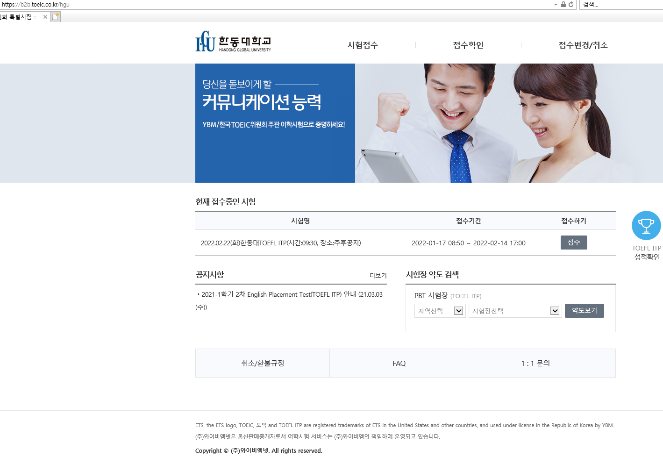
클릭
Click

Slide 2
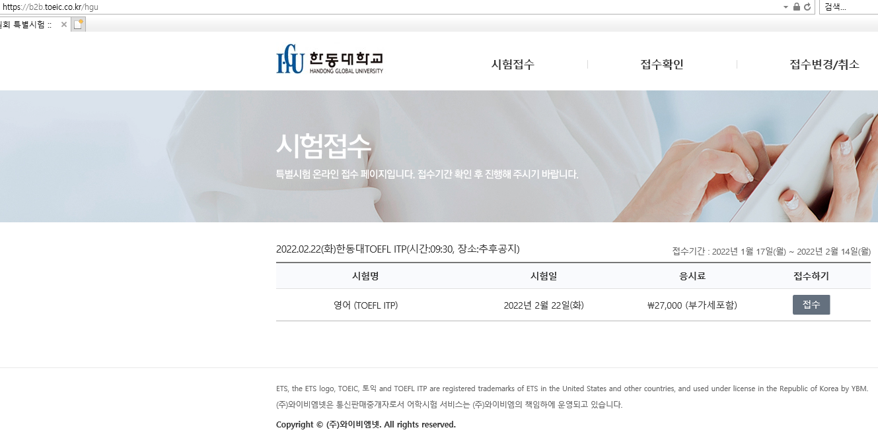
클릭
Click

Slide 3
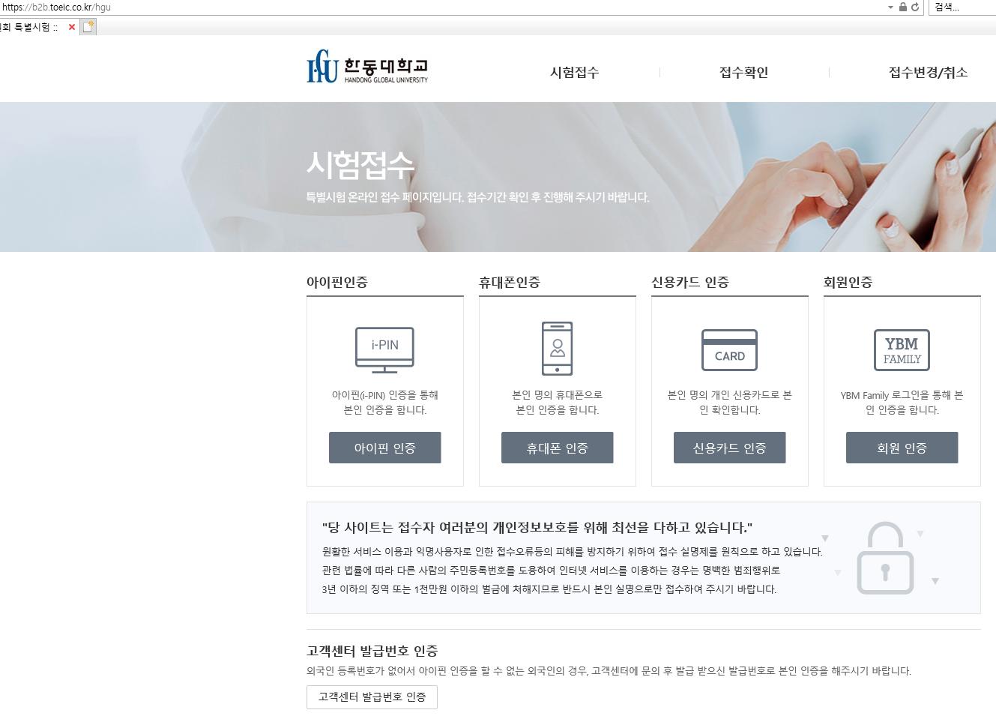
클릭
Click
For foreigners who can't authenticate the IPIN because they don't have a foreign registration number, please contact the customer center and authenticate yourself with the issued number.

Slide 4
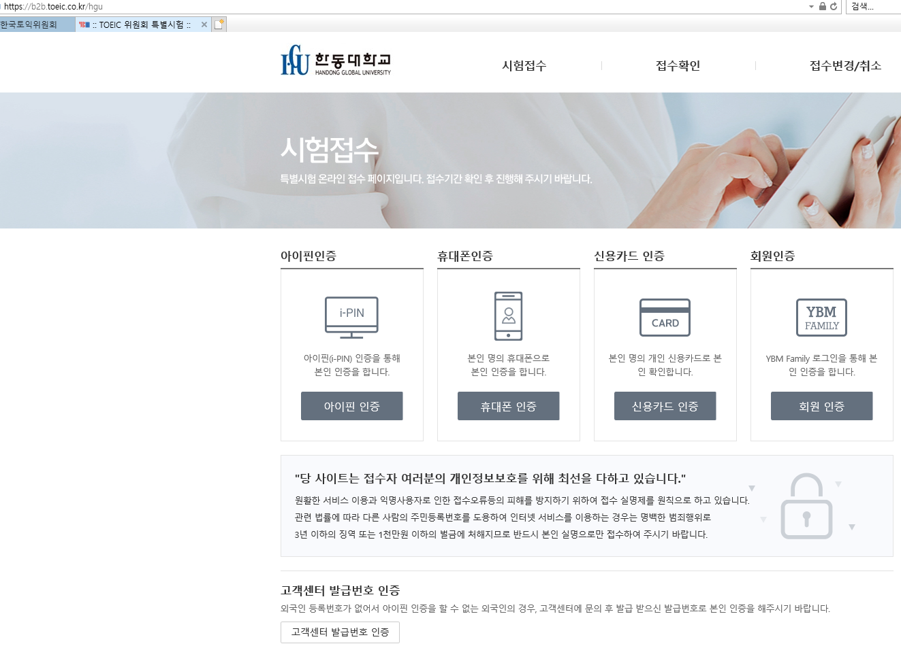
For foreigners who can't authenticate the IPIN because they don't have a foreign registration number, please contact the customer center and authenticate yourself with the issued number.
클릭
Click

Slide 5
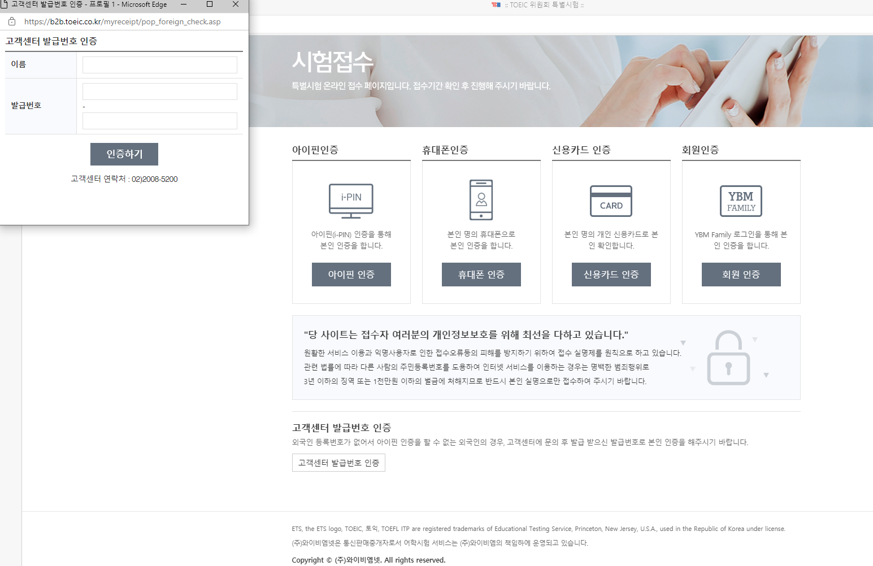
전화
Call the CS center
For foreigners who can't authenticate the IPIN because they don't have a foreign registration number, please contact the customer center and authenticate yourself with the issued number.

